Slide 1
Compiler Construction

Slide 2
Specification of Tokens
Strings and Languages
Operations on Languages
Regular Expressions
Regular Definitions
Extensions of Regular Expressions

Slide 3
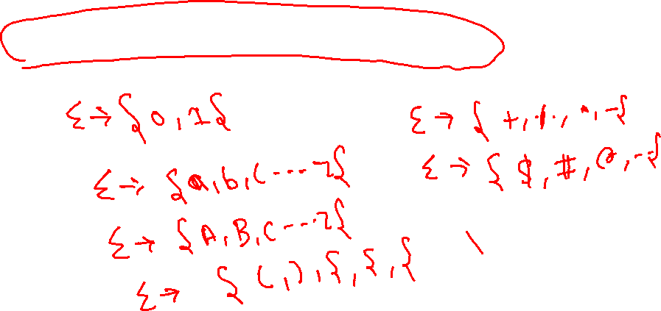
Specification of Tokens
Strings and Languages
Symbol – An atomic unit, such as a digit, character, lower-case letter, etc.
Alphabet :
An alphabet is a finite, non empty set of symbols.

Slide 4
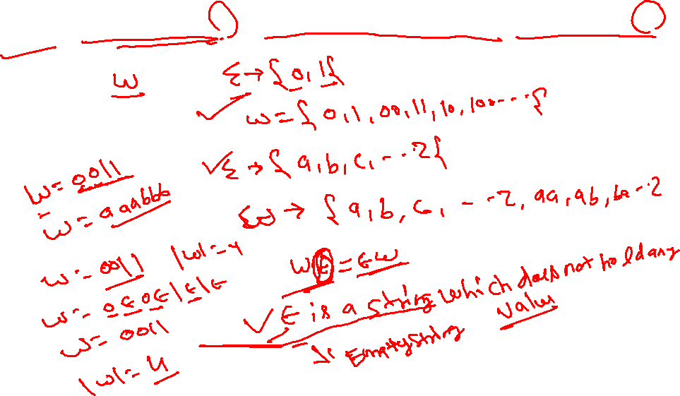
Specification of Tokens (contd.)
Strings and Languages (contd.)
A string over an alphabet Σ is a finite sequence of symbols drawn from Σ.
Notes:
The empty string is the identity element under concatenation; that is, for any string S, 𝜀S = S𝜀 = S.

Slide 5
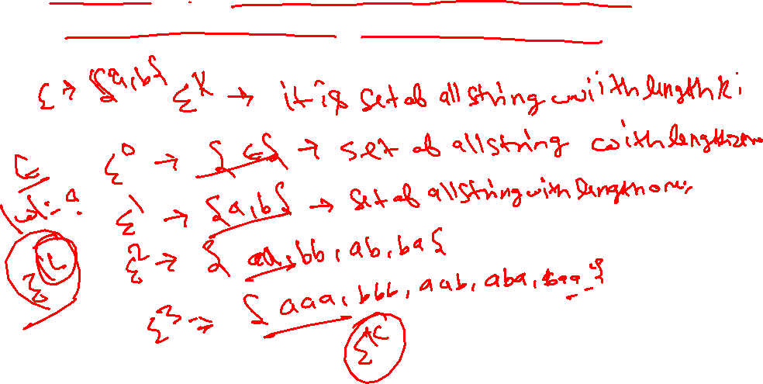
Specification of Tokens (contd.)
Strings and Languages (contd.)
If Σ is an alphabet, we can express the set of all strings of a certain length from that alphabet by using the exponential notation:

Slide 6
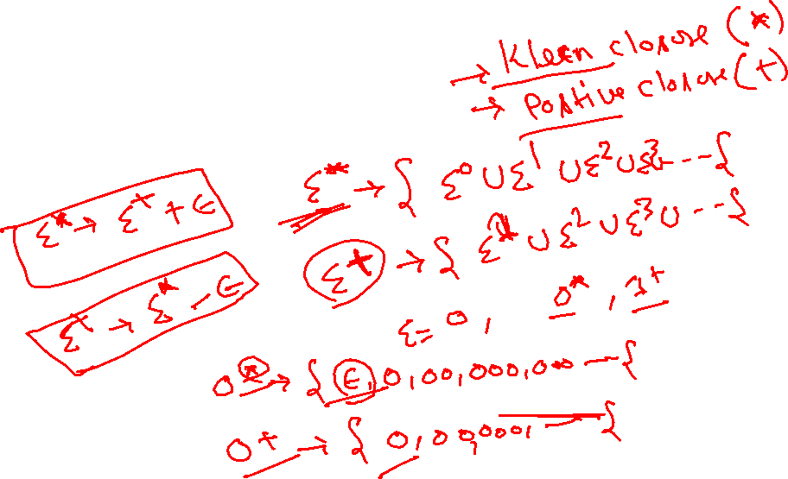
Specification of Tokens (contd.)
Strings and Languages (contd.)
Some special sets of strings:
Σ* All strings of symbols from Σ
Σ⁺ = Σ* - {ε}

Slide 7
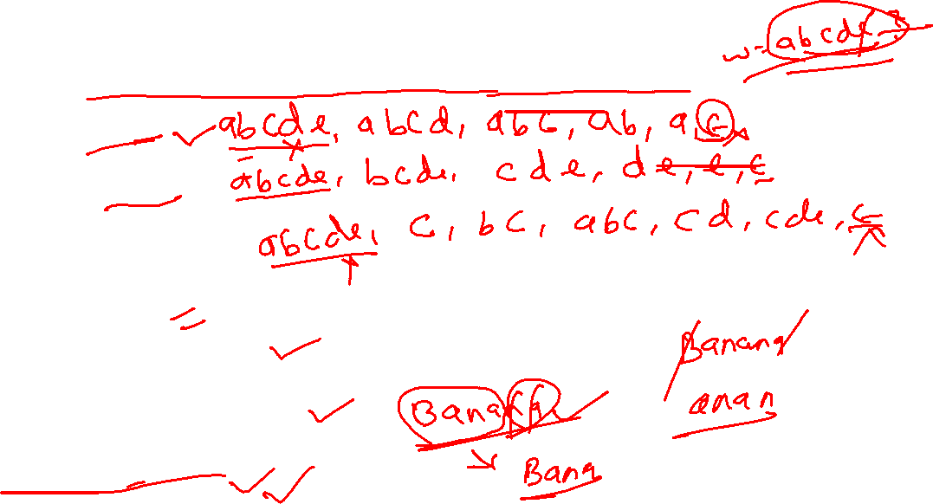
Specification of Tokens (contd.)
Strings and Languages (contd.)
The following string-related terms are commonly used:
Prefix:
Suffix:
Substring:
Proper prefix:
Proper suffix:
Proper substring:
Subsequence:

Slide 8
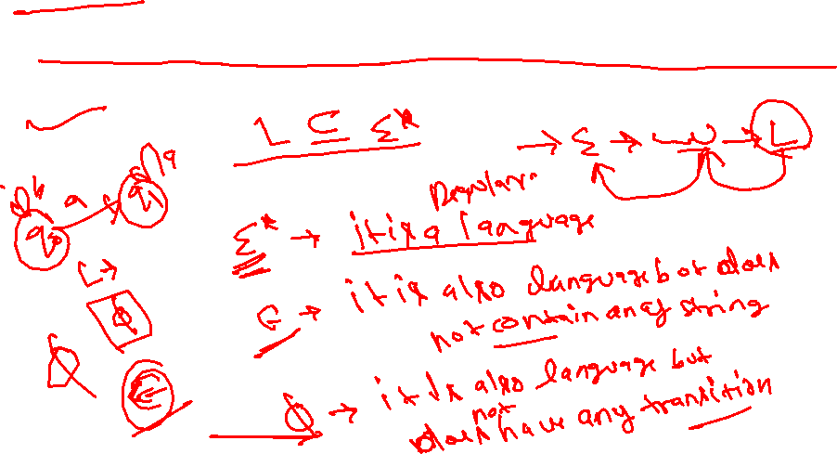
Specification of Tokens (contd.)
Strings and Languages (contd.)
Languages:
1) Any countable set of strings formed from some specific alphabet.
2) any subset L of Σ*

Slide 9
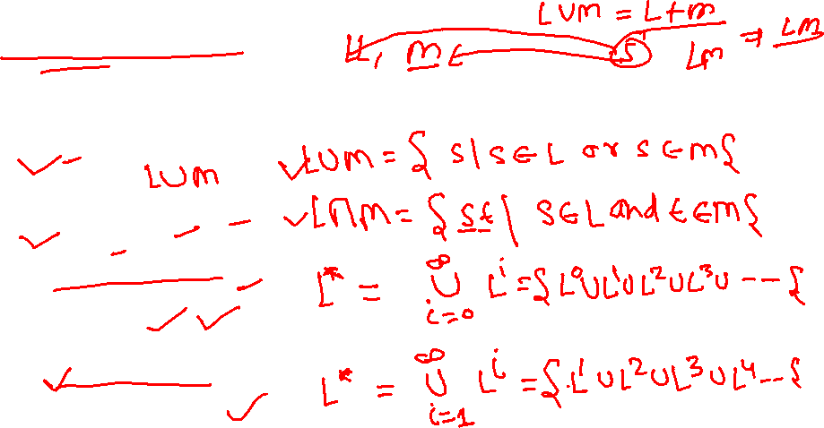
Operations on Languages:
Specification of Tokens (contd.)
Strings and Languages (contd.)
OPERATION
DEFINITION
union of L and M written L ∪ M
concatenation of L and M written LM
Kleene closure of L written L*
positive closure of L written L⁺
Notes:
Kleene Closure: L^{i} = L⁰ U L¹ U L² U…
Positive Closure: L^{i} = L¹ U L² U…

Slide 10
Specification of Tokens (contd.)
Strings and Languages (contd.)
Language Operations (Example) (contd.):
Let L = {A, B, …, Z, a, b, …, z} and D={0, 1,…, 9} be two languaes
L U D is the set of letters and digits
LD is the set of strings consisting of a letter followed by a digit
L⁴ is the set of all four-letter strings (Similarly, we write L^{n} for LL…L (n times))
L* is the set of all strings of letters, including the empty string ε
L(L U D) is the set of all strings of letters and digits beginning with a letter
D⁺ is the set of all strings of one or more digits

Slide 11
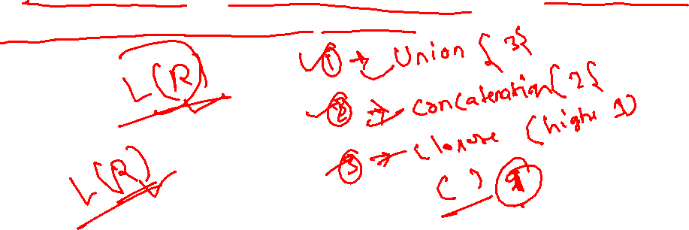
Regular Expressions
Specification of Tokens (contd.)
We use regular expressions to describe tokens of a programming language.
A Regular Expression is a set of Rules/Techniques for constructing sequences of symbols (Strings) from an alphabet.
Let Σ be an alphabet, r is a Regular Expression then L(r) is the Language that is characterized by the rules of r

Slide 12
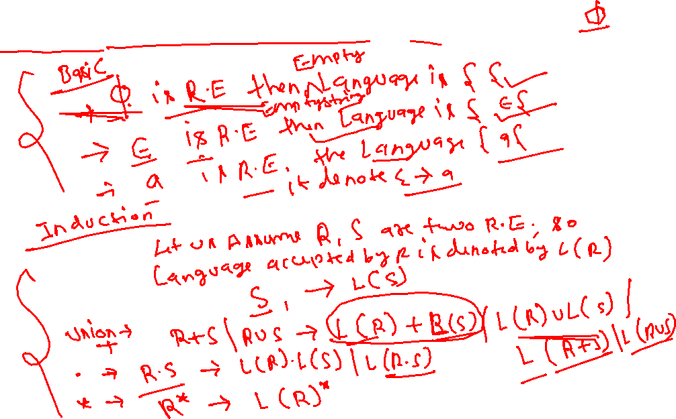
Formal definition of Regular Expressions
Specification of Tokens (contd.)

Slide 13
Formal definition of Regular Expressions
Specification of Tokens (contd.)

Slide 14
Rules for Specifying Regular Expressions:
Specification of Tokens (contd.)
Let Σ be an alphabet. The regular expressions over Σ are:
  Ø : Represents the empty set { }
  ε : Represents the set {ε}
  a : Represents the set {a}, for any symbol a in Σ
Let r₁ and r₂ be regular expressions that represent the sets L(r₁) and L(r₂), respectively.
  r₁|r₂ Represents the set L(r₁) U L(r₂) (precedence 3)
  r₁r₂ Represents the set L(r₁).L(r₂) (precedence 2)
  r* Represents the set L* (highest precedence)
  (r) Represents the set L(r) (not an op, provides precedence)
If r is a regular expression, then L(r) is used to denote the corresponding language.
Notes:
A regular expression is built up of simpler regular expressions (using defining rules)
Each regular expression denotes a language.
A language denoted by a regular expression is called as a regular set.

Slide 15
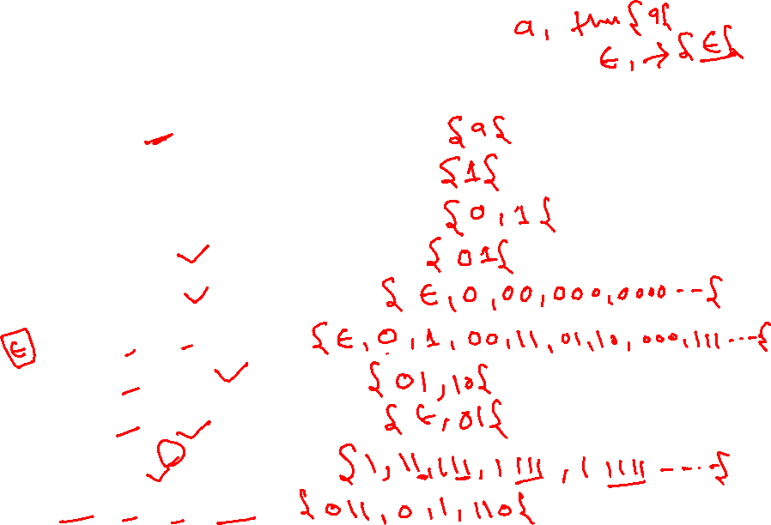
Regular Expressions (contd.)
Specification of Tokens (contd.)
Regular Expression | Regular Language
0
1
0 + 1
01
0*
(0 + 1)*
01 + 10
ε + 01
11*
011 + 0 + 1 + 110
Notes:
By the definition of Regular Expressions, the class of regular languages over Σ is closed under Union, Concatenation, and Closure.

Slide 16
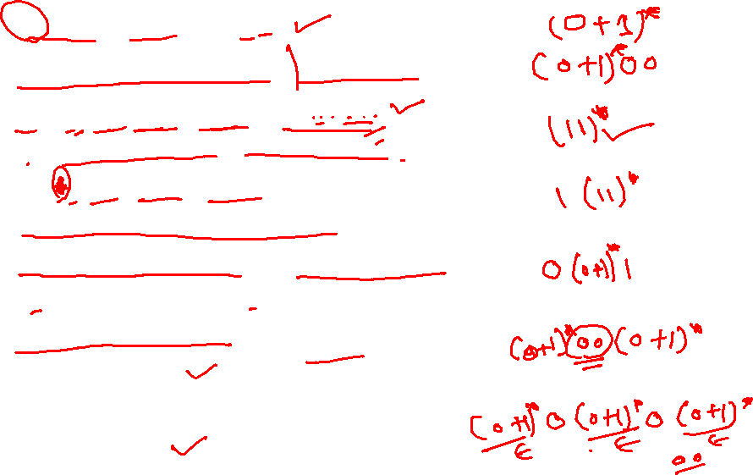
Regular Expressions (contd.)
Specification of Tokens (contd.)
Regular Language | Regular Expression
All strings of 0’s and 1’s
All strings of 0’s and 1’s, ending with 00
L = {ε, 11, 1111,111111,11111111,…} Set of all strings having even no. of 1’s
L = {1,111,11111,1111111,…} Set of all strings having odd no. of 1’s
All strings of 0’s and 1’s, beginning with a 0 and ending with a 1
All strings of 0’s and 1’s with at least two consecutive 0’s
All strings of 0’s and 1’s containing at least two 0’s
Notes:
By the definition of Regular Expressions, the class of regular languages over Σ is closed under Union, Concatenation, and Closure.

Slide 17
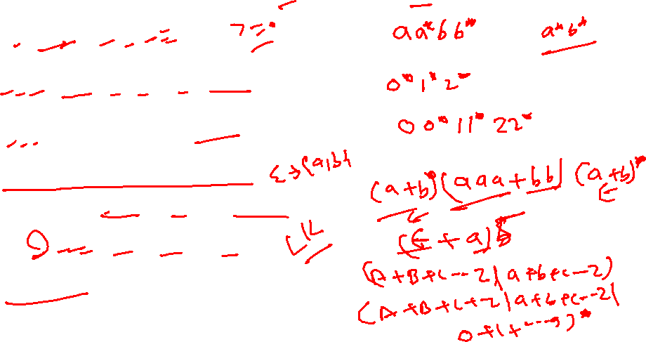
Regular Expressions (contd.)
Specification of Tokens (contd.)
Describe the following sets by Regular Expressions.
Regular Language | Regular Expression
L = {a^{n}b^{m} | n, m >=1}
0^{i}1^{j}2^{k} where i, j, and k >=0
0^{i}1^{j}2^{k} where i, j, and k >=1
Set of all strings over {a, b} containing aaa or bb as a substring
L={ε, a, aa, aaa, aaaa, aaaaa}
Pascal Identifier
Notes:
By the definition of Regular Expressions, the class of regular languages over Σ is closed under Union, Concatenation, and Closure.

Slide 18
Algebraic Properties of Regular Expressions
Specification of Tokens (contd.)
LAW
DESCRIPTION
r + s = s + r
+ is commutative
r + (s + t) = (r + s) + t
+ is associative
(r s) t = r (s t)
concatenation is associative
r ( s + t ) = r s + r t
( s + t ) r = s r + t r
concatenation distributes over +
εr = r
rε = r
ε Is the identity element for concatenation
r** = r*
* is idempotent

Slide 19
Regular Definitions
Specification of Tokens (contd.)
We can give names to regular expressions, and we can use these names as symbols to define other regular expressions.
Let Σ is an alphabet of basic symbols. The regular definition is a sequence of definitions of the form

Slide 20
Regular Definitions (contd.)
Specification of Tokens (contd.)
Regular Definitions: Associate names with Regular Expressions
For Example : PASCAL IDs

Slide 21
Regular Definitions (contd.)
Specification of Tokens (contd.)
Example : Unsigned numbers in PASCAL
1240, 39.45, 6.33E15, or 1.578E-41

Slide 22
Extensions of Regular Expressions
Specification of Tokens (contd.)
Basic operators of Regular Expressions: union, concatenation, and Kleene closure
Many extensions have been added to regular expressions to enhance their ability to specify string patterns.
Here we mention a few notationl extensions that were first incorporated into Unix utilities such as Lex that are particularly useful in the specification lexical analyzers.

Slide 23
Extensions of Regular Expressions (contd.)
Specification of Tokens (contd.)
Notational Shorthands
We often use the following shorthands:
One-or-more instances: ( + ) : r+ = rr* (r* = r⁺ + ε )
2. Zero or one instance ( ? ) : r? = r | ε
3. Character classes : [a-z] = a | b | … | z

Slide 24
Extensions of Regular Expressions (contd.)
Specification of Tokens (contd.)
PASCAL ID:
letter → A | B | C | … | Z | a | b | … | z
digit → 0 | 1 | 2 | … | 9
id → letter ( letter | digit )*
Using Shorthand : PASCAL IDs

Slide 25
Unsigned Number
Specification of Tokens (contd.)
Extensions of Regular Expressions (contd.)
digit → 0 | 1 | 2 | … | 9
digits → digit digit*
optional_fraction → . digits | ε
optional_exponent → ( E ( + | -| ε) digits) | ε
num → digits optional_fraction optional_exponent
Using Shorthand : Unsigned Number

